Slide 1
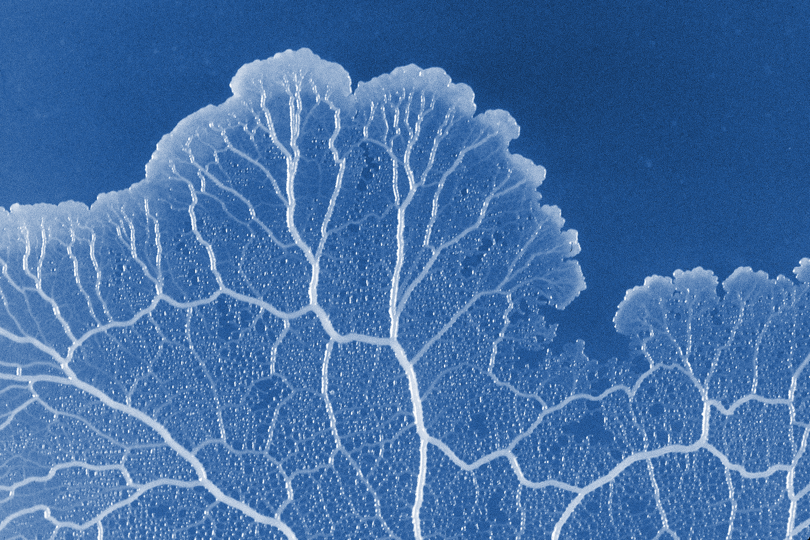
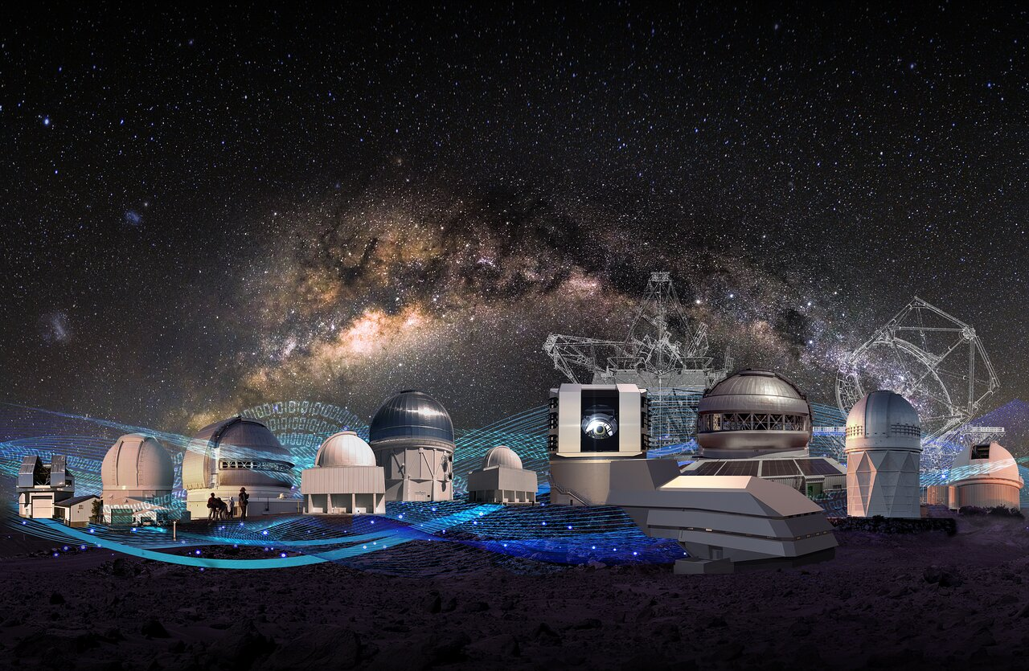


Galaxy Evolution: Investigating Paths of Reddening through Machine Learning Models
Isabella Olin
Advisor, Stephanie Juneau
DATE: 04/19/2025
Notes:
Hi! My name is Isabella Olin and today I wanted to tell you a little about a project I’ve had the pleasure of working on with Stephanie for my TIMESTEP Summer Internship.

Slide 2
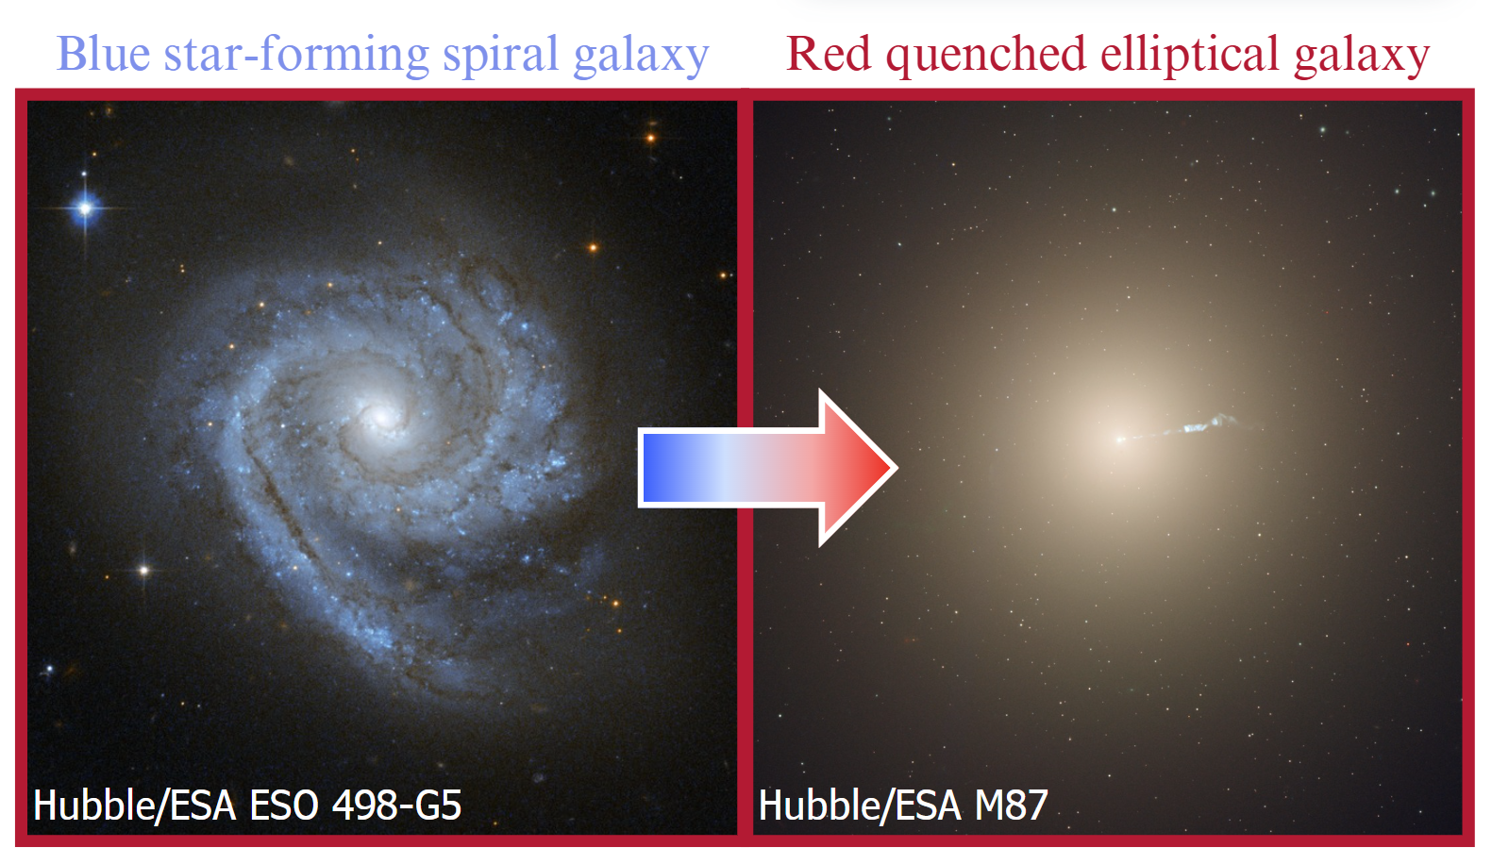
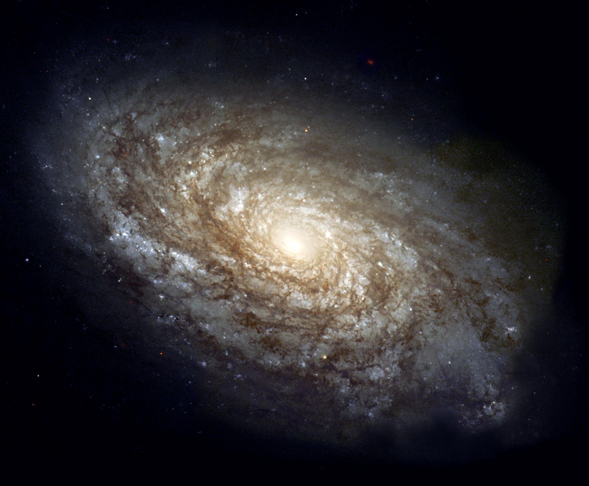
1
Paths of reddening
As galaxies evolve, they may become red due to decreased star formation (quenching) or dust
Quenching causes red galaxies because young blue stars die out leaving only red old stars behind
High dust content causes red galaxies because dust grains absorb blue light more than red light
Dusty spiral galaxy
Hubble NGC 4414
Notes:
include photos

Slide 3
Motivation:
Can we use machine learning models to identify different paths of reddening?

Slide 4
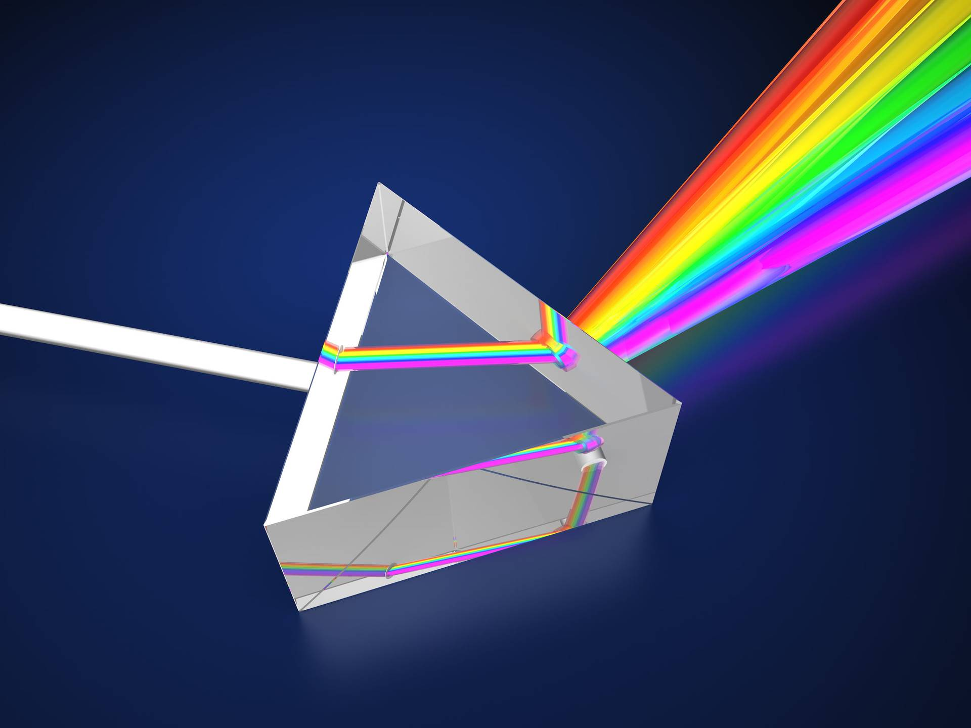
2
Data & Method
Context: Spectra plot the energy of the combined light from all of the stars in a galaxy versus wavelength
We use a dimensionality reduction algorithm (Pat et. al 2022) that categorizes galaxies based on similarities in their spectra and reduces them to 10 dimensions
ATA Scientific Instruments
Notes:
include photos

Slide 5
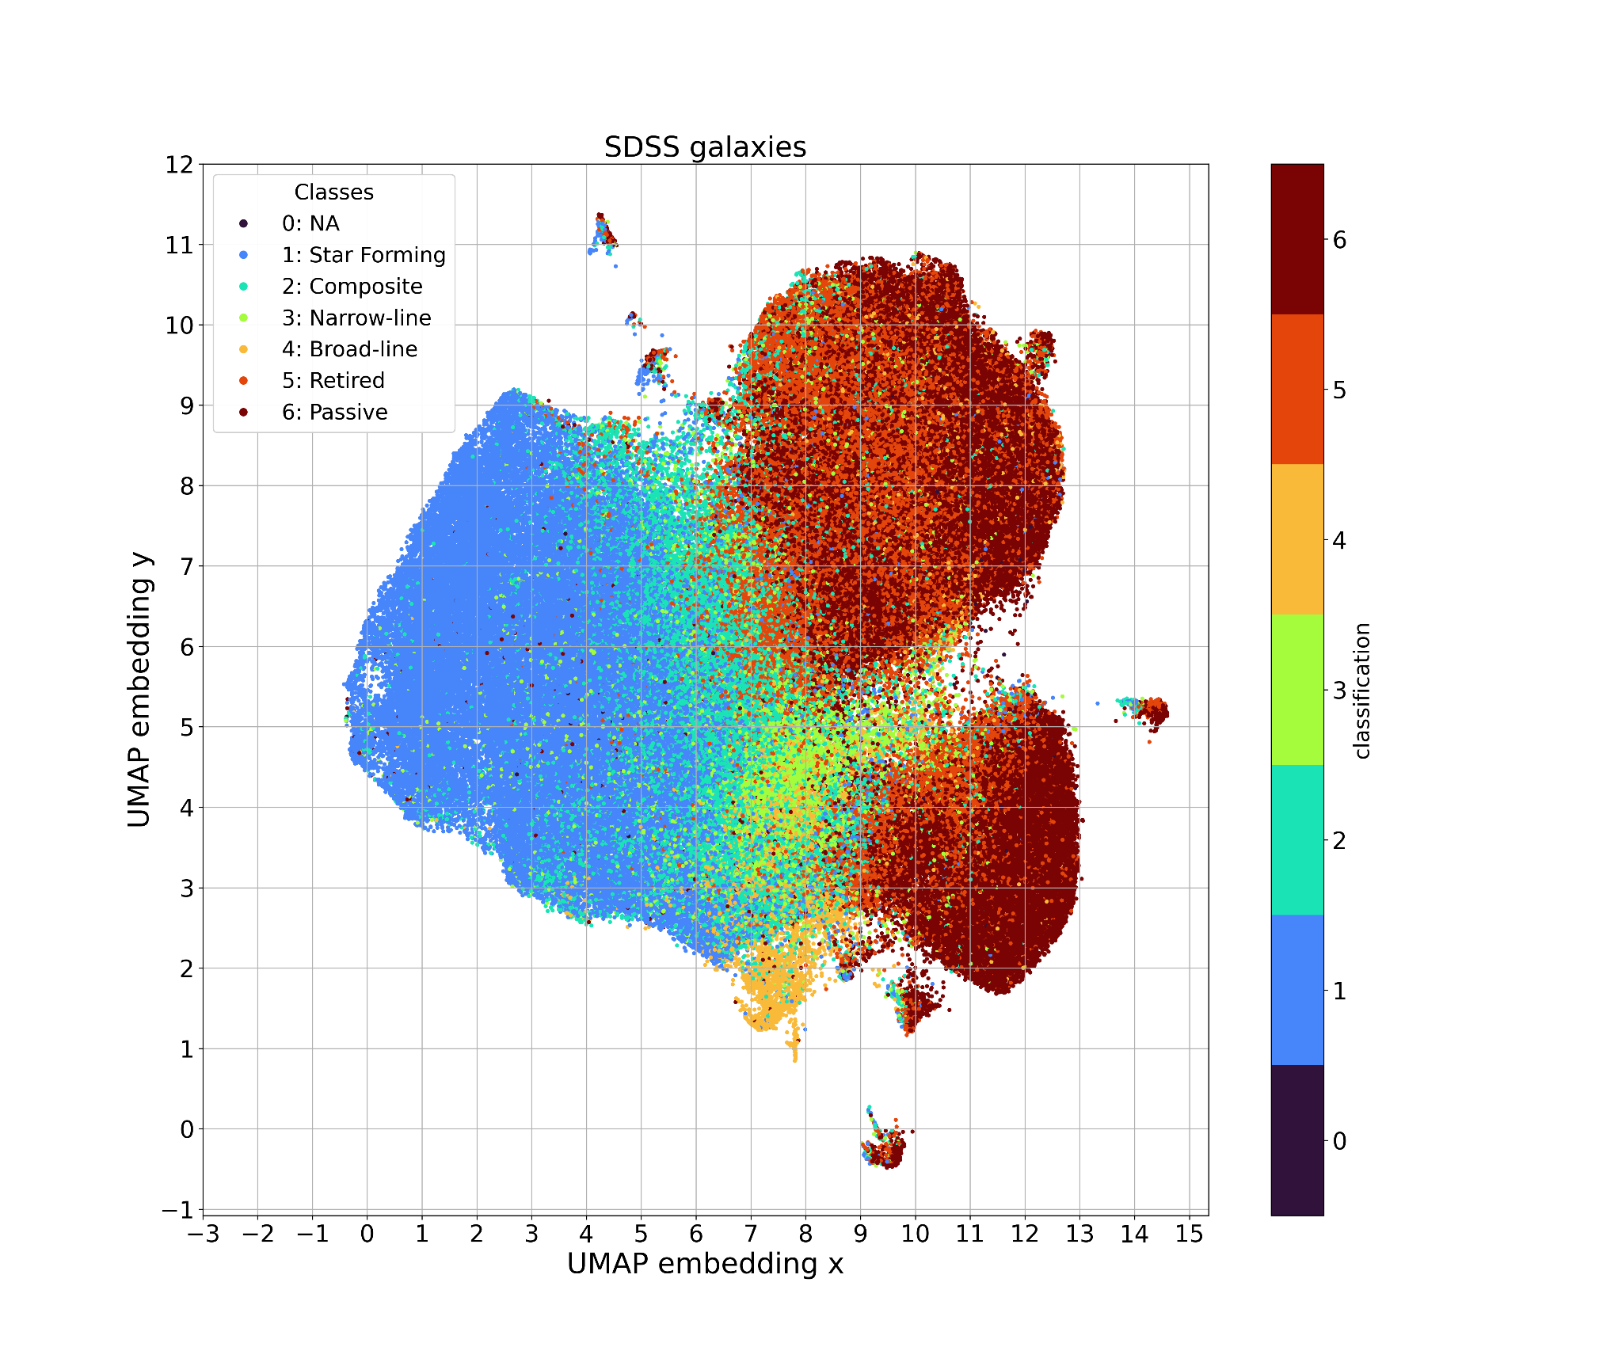
3
UMAP 2D Projection
A 2D projection of 10D compressed spectral data allows us to visually identify trends
Here, galaxies are color-coded by their classification
We focus on the red quenched galaxies on the right side, noting two visible “tails”
Credit: Pat et. al 2022
Notes:
for a backup slide:
Our generative model is heavily inspired by the work of Jones (2010)”
what is the Jones model and its significance to Cosmic Slime Catalog?
“In its original form, Jones’s algorithm imposes that agents’ trajectories maximize the deposit values encountered; our version samples possible paths probabilistically, such that paths toward smaller deposits may still be traversed, although less frequently. This stochastic process formulation enables us to frame the extracted 3D network as a probability density of the presence of filamentary structures, rather than an absolute maximum likelihood solution.”
developed by a team at UC Santa Cruz

Slide 6
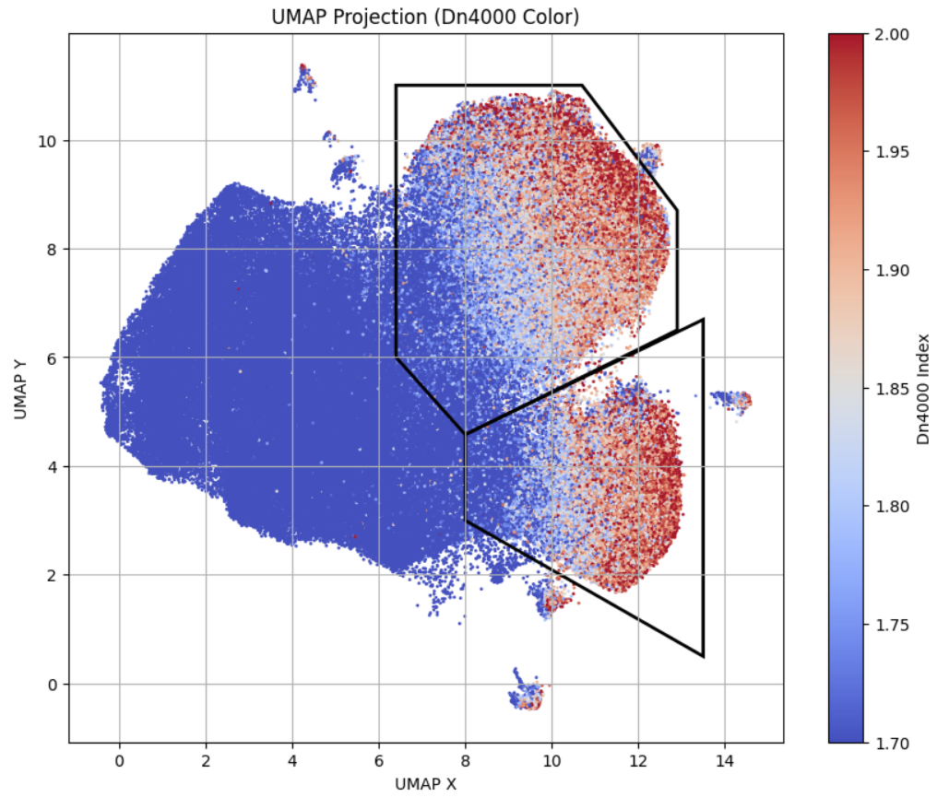
4
UMAP Color Plots
To look for evolutionary trends in the UMAP projection, we color-code galaxies by different properties (**cues on color maps)
For example, the Dn4000 index is a proxy for stellar age.
As expected from the previous slide, we see increasing Dn4000s as we go from star-forming to quenched galaxies
Notes:
for a backup slide:
Our generative model is heavily inspired by the work of Jones (2010)”
what is the Jones model and its significance to Cosmic Slime Catalog?
“In its original form, Jones’s algorithm imposes that agents’ trajectories maximize the deposit values encountered; our version samples possible paths probabilistically, such that paths toward smaller deposits may still be traversed, although less frequently. This stochastic process formulation enables us to frame the extracted 3D network as a probability density of the presence of filamentary structures, rather than an absolute maximum likelihood solution.”
developed by a team at UC Santa Cruz

Slide 7
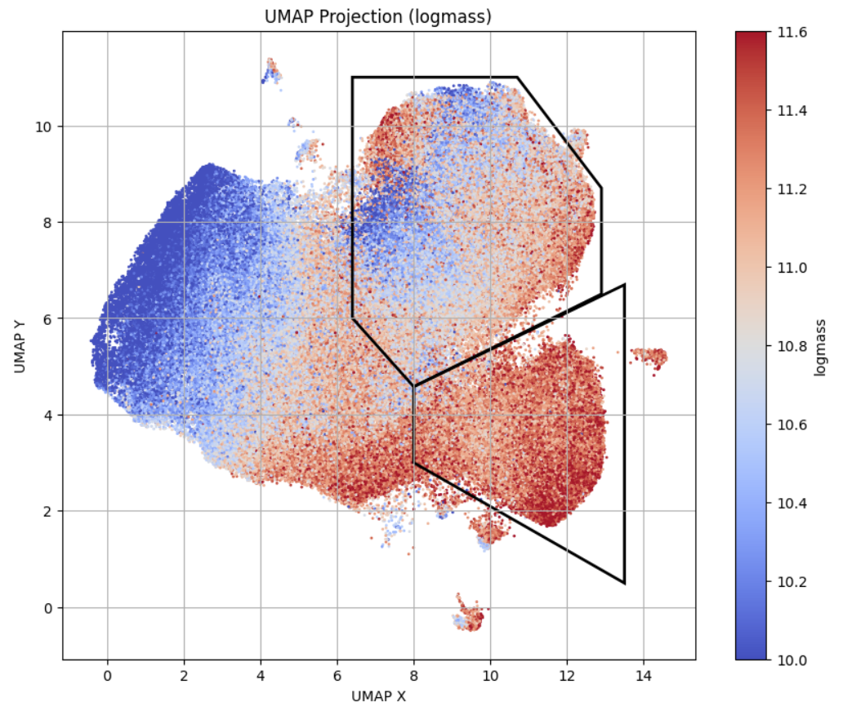
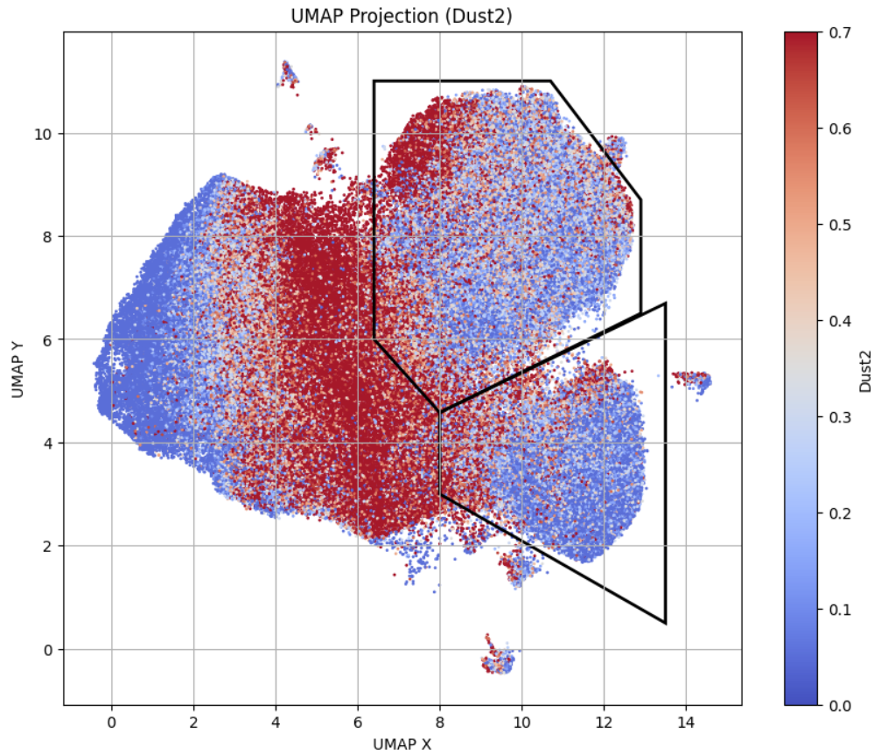
We analyze other properties determined by the Granada SDSS modeling (Conroy et al. 2009)
Here, we focus on logmass (stellar mass) and Dust2 (dust component coefficient)
5
Notes:
for a backup slide:
Our generative model is heavily inspired by the work of Jones (2010)”
what is the Jones model and its significance to Cosmic Slime Catalog?
“In its original form, Jones’s algorithm imposes that agents’ trajectories maximize the deposit values encountered; our version samples possible paths probabilistically, such that paths toward smaller deposits may still be traversed, although less frequently. This stochastic process formulation enables us to frame the extracted 3D network as a probability density of the presence of filamentary structures, rather than an absolute maximum likelihood solution.”
developed by a team at UC Santa Cruz

Slide 8
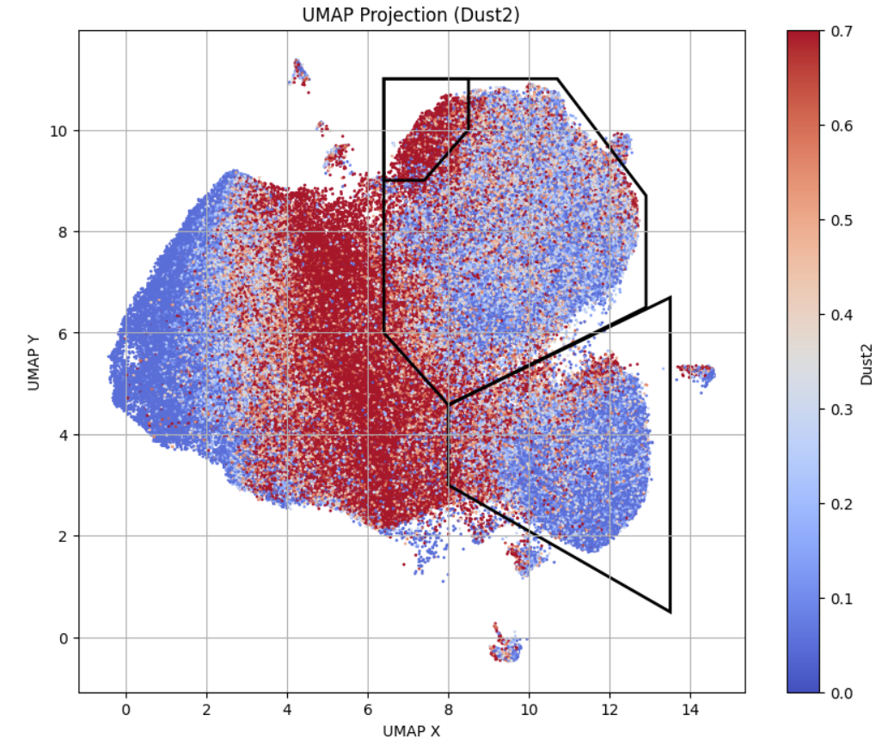
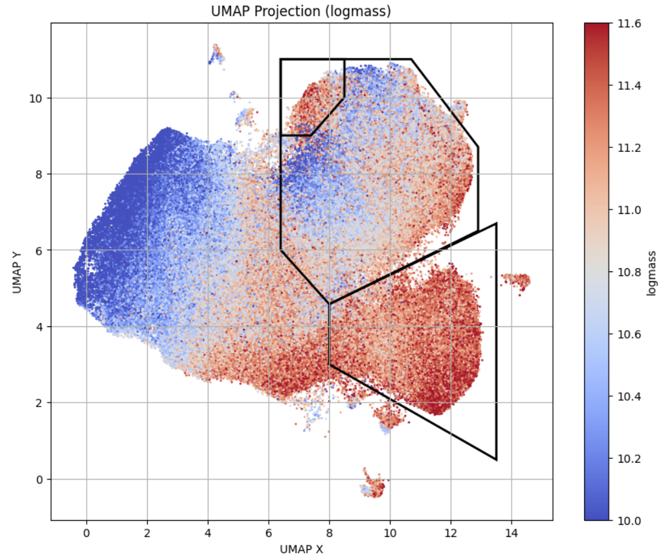
By looking at these properties we notice a group of outliers in the upper tail, which appear to have higher mass and dust content. We investigate these outliers further.
6
Notes:
for a backup slide:
Our generative model is heavily inspired by the work of Jones (2010)”
what is the Jones model and its significance to Cosmic Slime Catalog?
“In its original form, Jones’s algorithm imposes that agents’ trajectories maximize the deposit values encountered; our version samples possible paths probabilistically, such that paths toward smaller deposits may still be traversed, although less frequently. This stochastic process formulation enables us to frame the extracted 3D network as a probability density of the presence of filamentary structures, rather than an absolute maximum likelihood solution.”
developed by a team at UC Santa Cruz

Slide 9
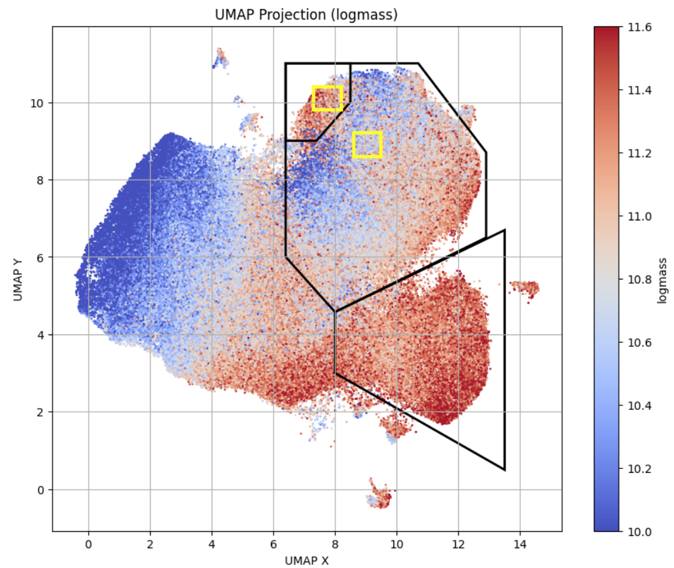
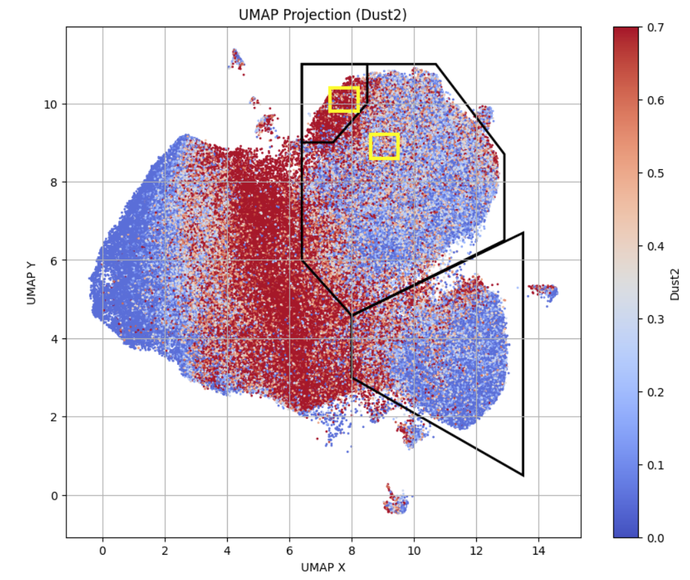
We select a box of outliers and a box of control passive galaxies
These regions were chosen to have similar Dn4000 indexes
7
Notes:
for a backup slide:
Our generative model is heavily inspired by the work of Jones (2010)”
what is the Jones model and its significance to Cosmic Slime Catalog?
“In its original form, Jones’s algorithm imposes that agents’ trajectories maximize the deposit values encountered; our version samples possible paths probabilistically, such that paths toward smaller deposits may still be traversed, although less frequently. This stochastic process formulation enables us to frame the extracted 3D network as a probability density of the presence of filamentary structures, rather than an absolute maximum likelihood solution.”
developed by a team at UC Santa Cruz

Slide 10
Visual Analysis: Color Images

Slide 11
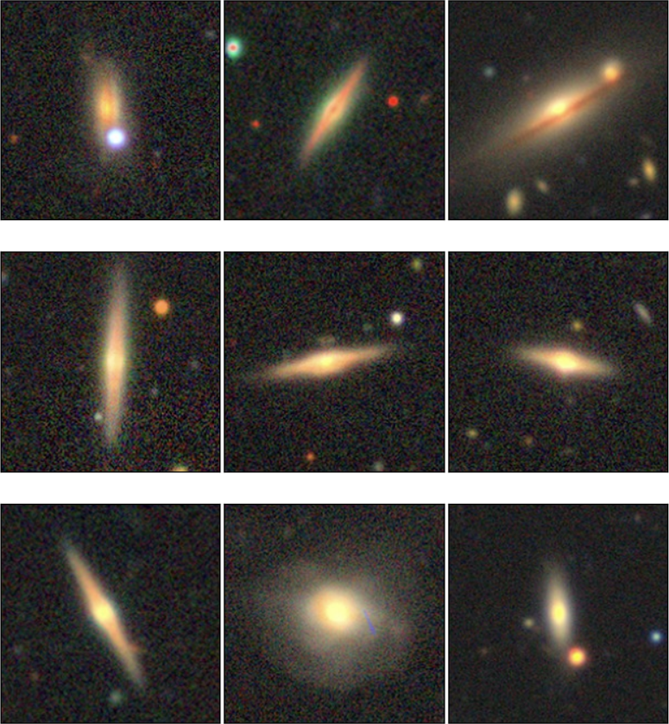
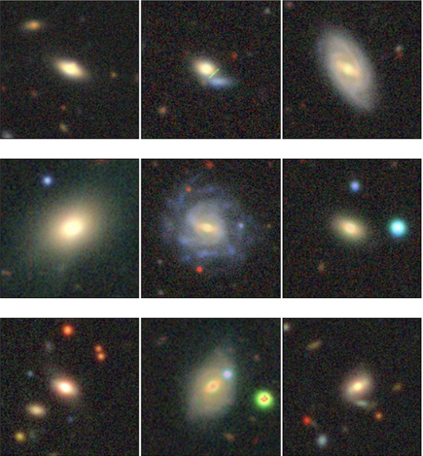
Outlier Passive Galaxies
Control Passive Galaxies
8
Legacy Survey DR9 (LS Viewer)

Slide 12
Spectra and results
We combine 1300 outlier spectra and 2086 control spectra to achieve a higher signal-to-noise ratio and average properties in each group

Slide 13

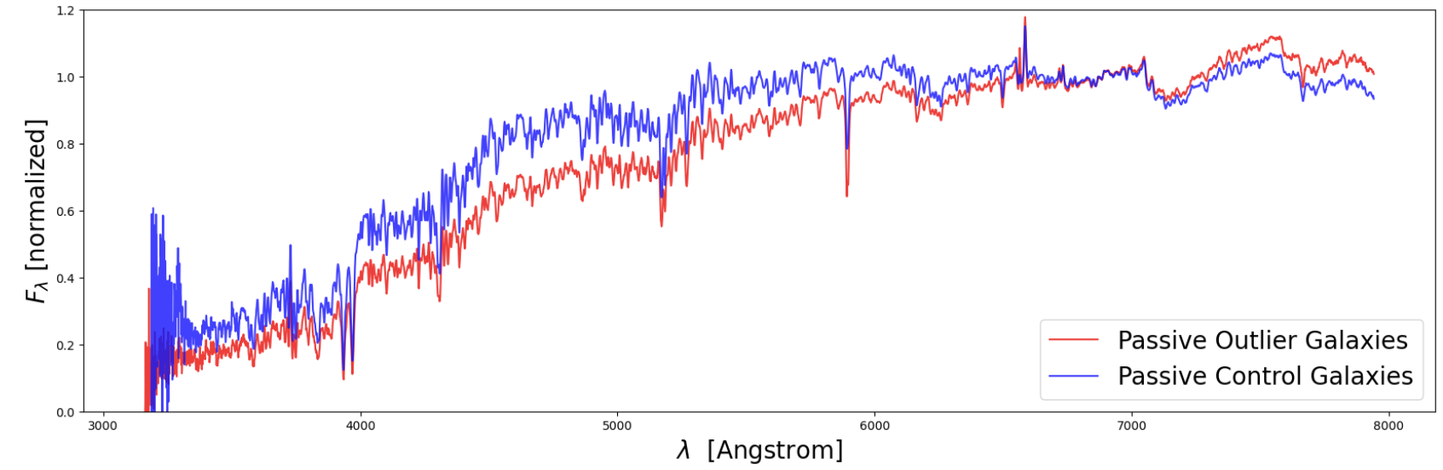
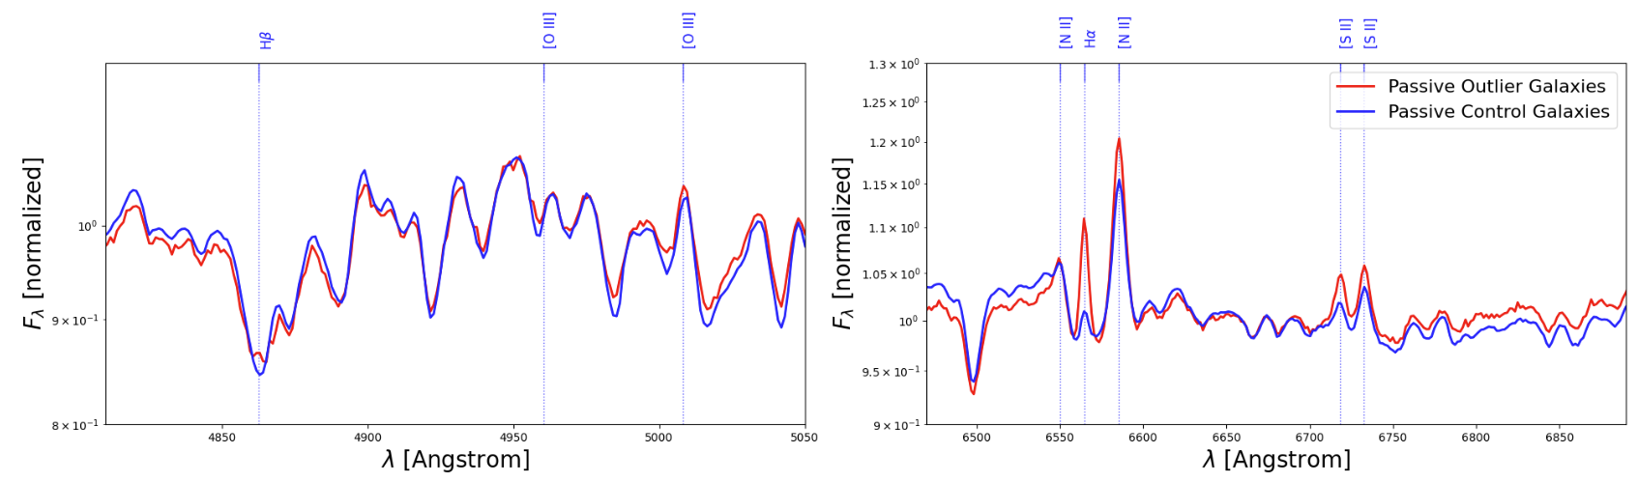
Continuum
9
Emission Lines
Notes:
I need conclusion to synthesize observations >>> old stellar population with little star formation indicates quenching

Slide 14
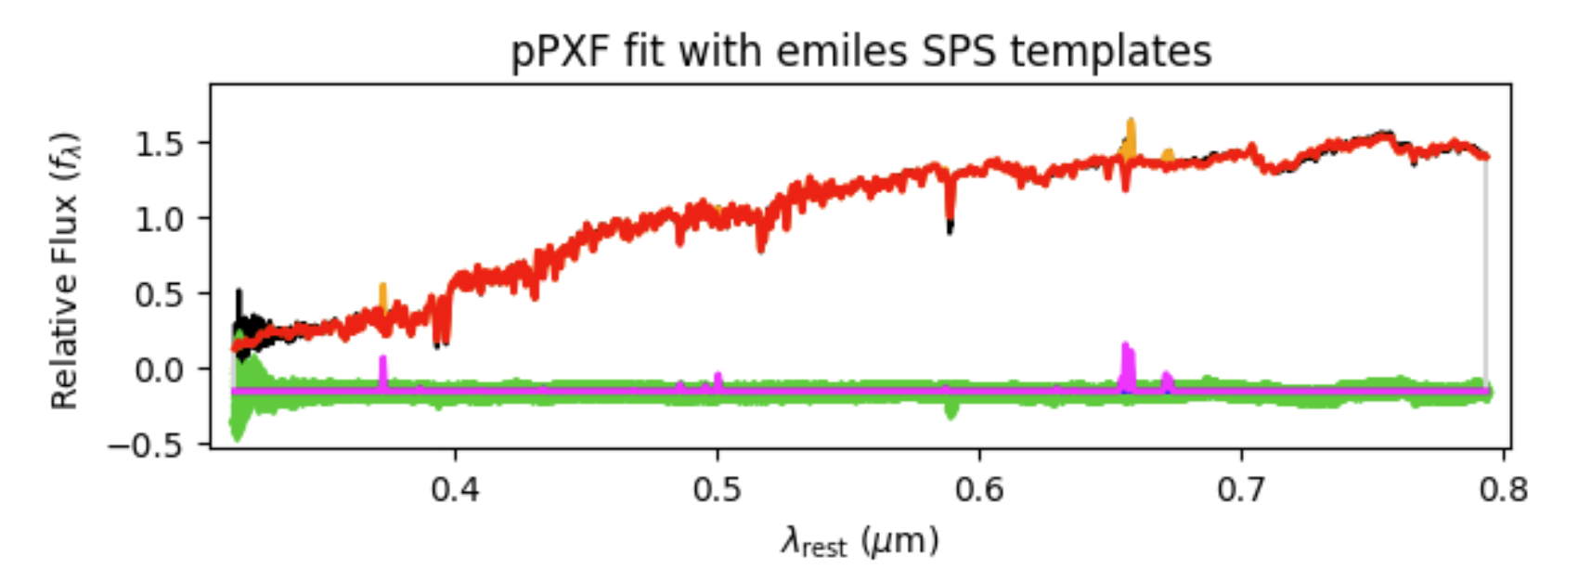
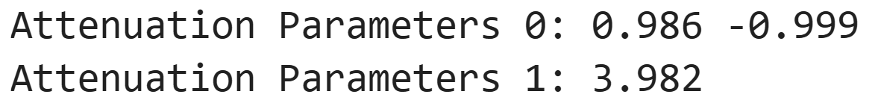
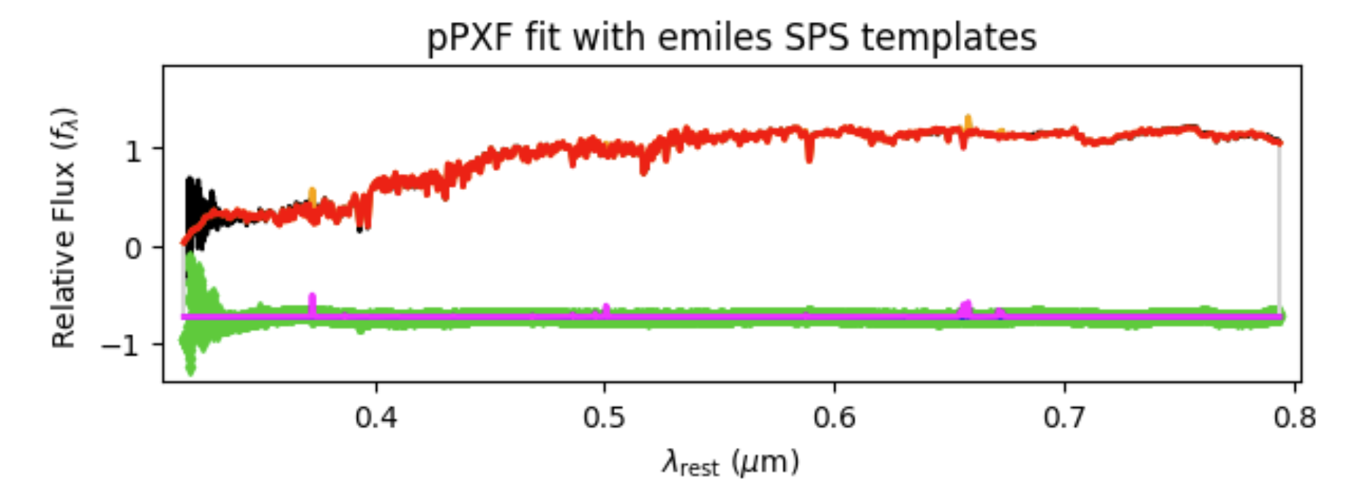

Outlier Passive Galaxies
10
Next Steps And Conclusion
In progress: interpreting fitted stellar models to infer properties of the galaxies’ stellar populations
Conclusion: These outliers are mostly reddened because they are seen edge-on and dusty. They have higher star formation than the surrounding passive galaxies
Control Passive Galaxies
Notes:
for a backup slide:
Our generative model is heavily inspired by the work of Jones (2010)”
what is the Jones model and its significance to Cosmic Slime Catalog?
“In its original form, Jones’s algorithm imposes that agents’ trajectories maximize the deposit values encountered; our version samples possible paths probabilistically, such that paths toward smaller deposits may still be traversed, although less frequently. This stochastic process formulation enables us to frame the extracted 3D network as a probability density of the presence of filamentary structures, rather than an absolute maximum likelihood solution.”
developed by a team at UC Santa Cruz

Slide 15
Acknowledgements
Thank you to my advisor, Stéphanie Juneau, for her continued support through this project and my internship. This work was supported by funding from the TIMESTEP Summer Tech Internship Program and the NOIRLab. The University of Arizona NASA Space Grant Internship Program has provided funding for me to conduct a follow-up project through the academic year. This research uses services or data provided by the SPectra Analysis and Retrievable Catalog Lab (SPARCL) and the Astro Data Lab, which are both part of the Community Science and Data Center (CSDC) Program of NSF NOIRLab. NOIRLab is operated by the Association of Universities for Research in Astronomy (AURA), Inc. under a cooperative agreement with the U.S. National Science Foundation.

Slide 16
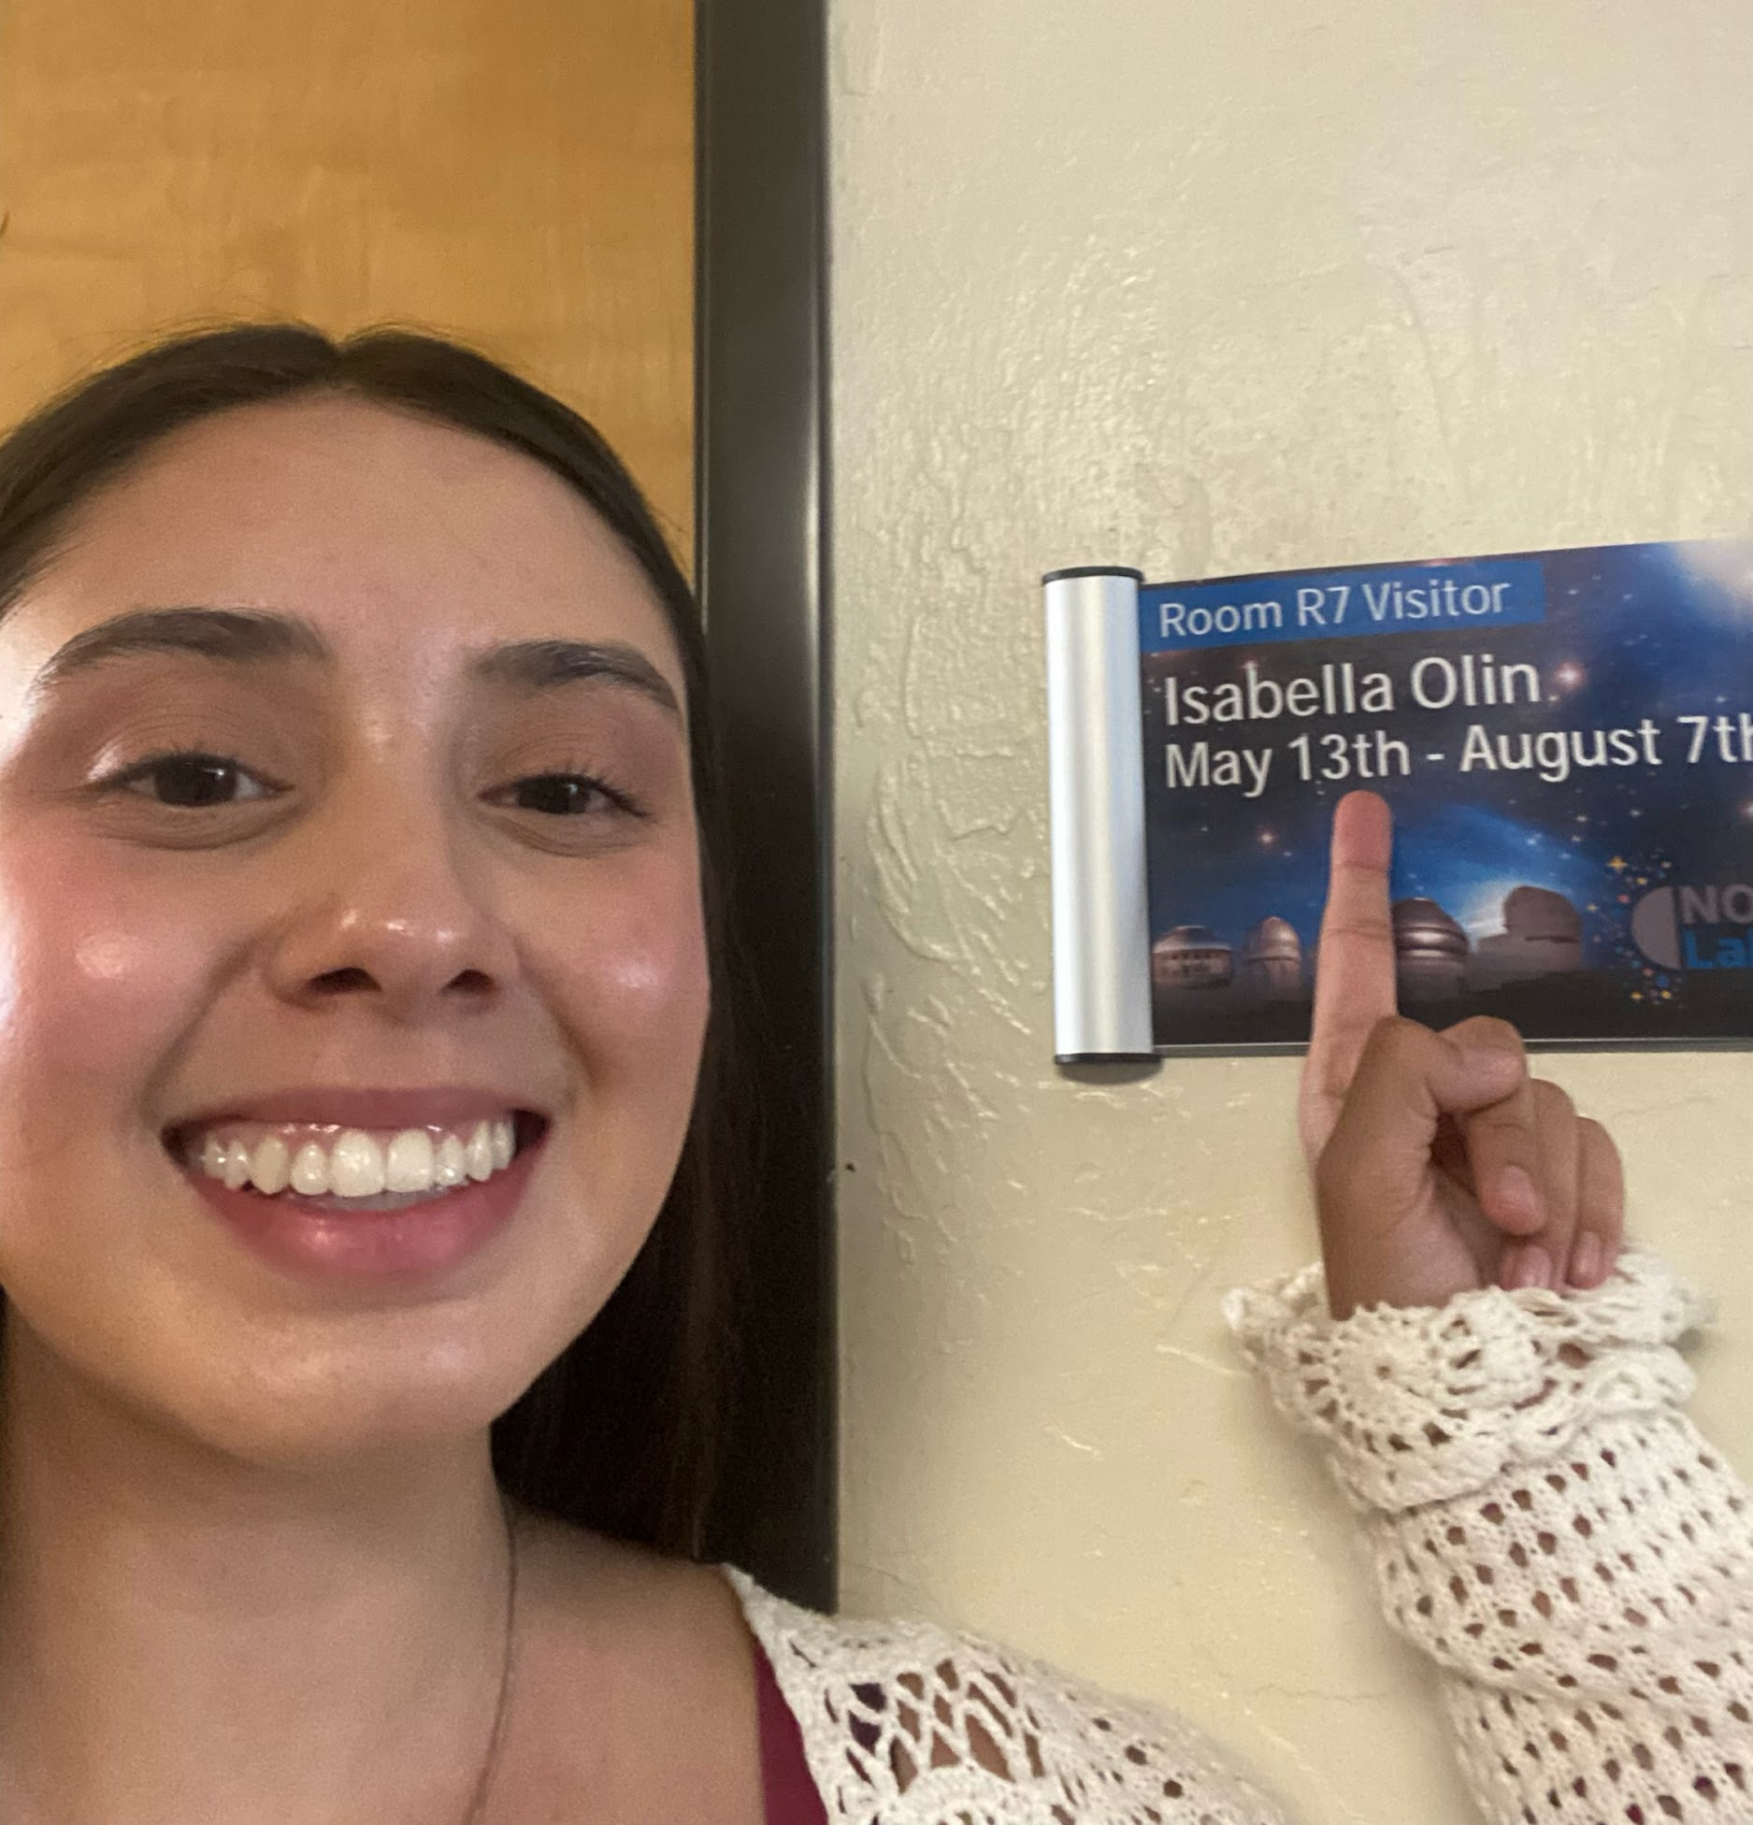
Thank you
iolin@arizona.edu
Notes:
put backup slides after thank you!

